Slide 1
MOVING OUT OF LONDON
NORTH LONDON TO HERTFORDSHIRE

Slide 2
MOVING FROM NORTH LONDON TO HERTFORDSHIRE
Due to high prices in London many people choose to move out of the city to buy property
The choice of where to move is often influenced by the need to commute into London for work
This means that many of the most popular places to live in the surrounding counties are rail towns, but which are the most suitable?

Slide 3
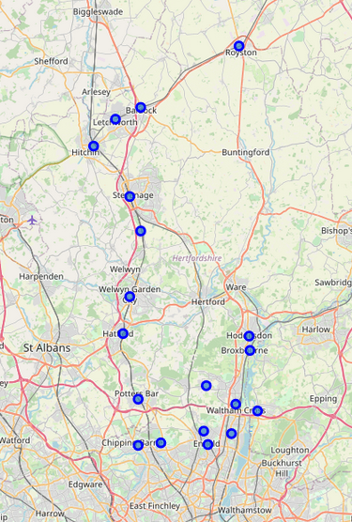
Rail stations in enfield and hertfordshire
There are many locations to choose from on the Hertfordshire rail line into Kings Cross so analysis to compare them with locations in Enfield will be helpful in deciding which are most suitable.

Slide 4
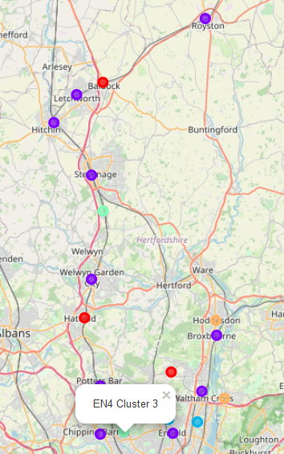
Location analysis – Comparing enfield and Hertfordshire
Using Foursquare venue data we can analyse which locations are similar to each other by grouping (clustering) similar locations together.
I am looking for somewhere similar to EN4 and the data clusters it with 1 other location, Knebworth

Slide 5
Location analysis – Comparing enfield and Hertfordshire
We can also see that the 2 nearest towns/cities (Stevenage & Welwyn) to Knebworth are clustered with the 2 nearest towns/cities to EN4. Making Knebworth a very good match to EN4 in terms of local ameneties.

Slide 6
Location analysis – Comparing enfield and Hertfordshire
EN4 – East Barnet
SG3 - KNEBworth
Average property value
£609,512
10% deposit
£60,951
Commute time to Kings Cross
Rail from Hadley Wood: 29 minutes
Monthly rail ticket: £195.10
Annual rail ticket: £2032
Average property value
£457,394
10% deposit
£45,739
Commute time to Kings Cross
Rail from Knebworth: 26 minutes
Monthly rail ticket: £334.90
Annual rail ticket: £3488

